Slide 1

ALGORITHMIZATION
AND
PROGRAMMING
PART II
ALA-TOO INTERNATIONAL UNIVERSITY
Spring Semester 2025-2026

Slide 2


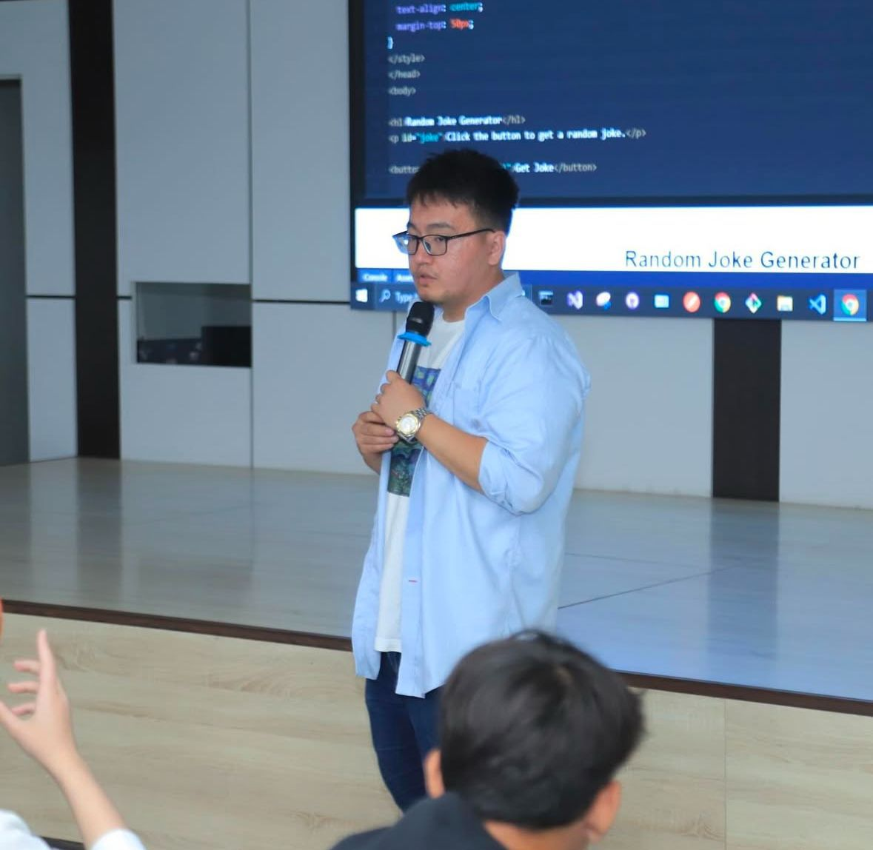
Lecturer
Nurbekov Mirlan
Office: H 207
Monday–Friday, 08:00–17:00
mirlan.nurbekov@alatoo.edu.kg

Slide 3
***
Bad programmers worry about the code. Good programmers worry about data structures and their relationships.
— Linus Torvalds

Slide 4
FINAL GRADE CALCULATION
MIDTERM ASSESSMENT + FINAL ASSESSMENT
Final Grade = Midterm Assessment (40%) + Final Project (60%)
– – –
Midterm Assessment = accumulated score (attendance + progress + test)
Final Project = individual project evaluation

Slide 5
MIDTERM ASSESSMENT BREAKDOWN
100 POINTS
10% - attendance
10% - active participation in discussions and in-class exercises
20% - weekly project progress
60% - online test (openbook)

Slide 6
FINAL ASSESSMENT
100 POINTS
ONLINE EXAMINATION

Slide 7

FROM CODE TO ALGORITHMIC THINKING
THINKING OVER CODING
IF TWO PROGRAMS GIVE THE SAME CORRECT OUTPUT, ARE THEY EQUALLY GOOD

Slide 8
THE INDUSTRY ANSWER
CORRECTNESS IS ONLY THE MINIMUM
Correct code can still be:
too slow AND/OR too memory-hungry AND/OR Impossible to scale
Industry rewards SURVIVABLE solutions, not just correct ones

Slide 9
WHAT AN ALGORITHM REALLY IS
A STRATEGY UNDER CONSTRAINTS
An algorithm is not just code, it is a decision process
Decisions are limited by: Worst-case risk
Time
Memory
Input size
Reliability

Slide 10
SCALE CHANGES EVERYTHING
INSIGHT
Input size matters more than code style
Algorithms fail when assumptions fail
Most bugs appear only at scale

Slide 11
THREE ALGORITHMIC WORLDS
DIFFERENT STRATEGIES FOR DIFFERENT REALITIES
1 - Simple and exhaustive
2 - Structured and optimized
3 - Fast but approximate

Slide 12
BRUTE-FORCE ALGORITHMS
SIMPLE AND RELIABLE BUT EXHAUSTIVE
The idea is to try every possibility
Easy to implement
Easy to understand
Performance collapses as data grows
Used for:
Small inputs
Prototypes
Learning

Slide 13
BRUTE-FORCE ALGORITHMS
EXAMPLES
Linear Search
Naive String Matching
Exhaustive Subset Search
Brute-force Password Cracking

Slide 14
BRUTE-FORCE ALGORITHMS
CHARACTERISTICS
Simple logic
Easy to implement
No assumptions about data
Performance degrades rapidly with scale

Slide 15
BRUTE-FORCE ALGORITHMS
IN THE REAL WORLD
Password strength checkers (short passwords)
Input validation for small datasets
Game AI at low difficulty levels
Early-stage prototypes and MVPs

Slide 16
STRUCTURED AND OPTIMIZED ALGORITHMS
FAST BECAUSE THEY USE ORDER
It uses structure in data (require preparation)
Much better scalability
But very complex to design
Used for:
Large datasets
Databases
Search systems

Slide 17
STRUCTURED AND OPTIMIZED ALGORITHMS
EXAMPLES
Binary Search
Merge Sort
Quick Sort
Tree Traversals
Hash-based Lookup

Slide 18
STRUCTURED AND OPTIMIZED ALGORITHMS
CHARACTERISTICS
Require ordered or structured data
Much better scalability
Slightly harder to design
Core of high-performance systems

Slide 19
STRUCTURED AND OPTIMIZED ALGORITHMS
IN THE REAL WORLD
Database indexing (B-Trees, Hash Indexes)
File systems (directory trees)
Search engines (sorted indexes)
In-memory caches (HashMaps)

Slide 20
HEURISTIC AND GREEDY ALGORITHMS
FAST BUT NOT ALWAYS PERFECT
The idea is on making local decisions. Often “good enough” for most cases, cuz it is extremely fast but not guaranteed optimal performance.
Used for:
Real-time systems
Navigation
Scheduling
Recommendations

Slide 21
HEURISTIC AND GREEDY ALGORITHMS
EXAMPLES
Greedy Scheduling
Huffman Coding
Nearest Neighbor Search
Heuristic Pathfinding

Slide 22
HEURISTIC AND GREEDY ALGORITHMS
CHARACTERISTICS
Extremely fast
Local decision-making
Not always optimal
Predictable performance

Slide 23
HEURISTIC AND GREEDY ALGORITHMS
IN THE REAL WORLD
GPS navigation (fastest good route)
Task scheduling in operating systems
Network routing decisions
Load balancing systems

Slide 24
A HARD TRUTH
REAL SYSTEMS MIX ALL OF THEM
Trade-offs are everywhere
Optimized algorithms at core
Heuristics for speed
Simple algorithms at edges

Slide 25
WHY NOT ALWAYS USE THE BEST ALGORITHM
ENGINEERING IS ABOUT COMPROMISES
Requirements change
Data grows unexpectedly
Deadlines exist
Simple code is easier to fix

Slide 26
WHAT EXPERIENCED DEVELOPERS KNOW
THE BEST ALGORITHM TODAY MAY FAIL TOMORROW
Over-optimization creates fragile systems
Flexibility often beats perfection
Choosing when to optimize matters

Slide 27
EFFICIENCY WITHOUT FORMULAS
INPUT GROWS AND COST EXPLODES
Small input → everything works
Medium input → slow
Large input → system failure

Slide 28
HARD TRUTH
ALGORITHMS DON'T FAIL - ASSUMPTIONS DO
Wrong assumptions about:
Input size
Data distribution
User behavior
Lead to system collapse

Slide 29
MAIN ALGORITHMIC PARADIGMS
DIFFERENT PROBLEMS NEED DIFFERENT THINKING
Divide and Conquer
Greedy
Dynamic Programming
Graph-based algorithms

Slide 30
NEXT WEEK PREVIEW
COMING SOON
GROWTH
PREDICTION
LIMITS
TRADE-OFFS

